Slide 1
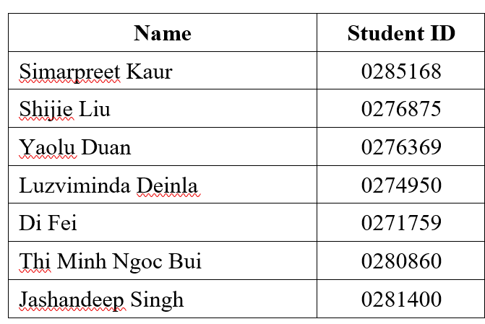
HELLO!
Team 3

Slide 2
The Decrease in Sales of a Cheese Company and Recommendations for Improvement

Slide 3
Contents
01.
Introduction
Introduce the company
02.
Problem Definition
Define the problem that the company face
03.
Business Analysis
Analytics the reasons that leads to the problem
04.
Recommendation
Recommendation for solving the problem
05.
Conclusion

Slide 4

1. Introduction
Laughing Cow cheese products are sold in more than 100 countries since they were founded nearly a century ago.
However, the sales significantly decreased in the years 2020 and 2021 as compared to the years before, specifically in the Vietnam market.
Our purpose is to analyze the decrease in sales for The Laughing Cow cheese company to improve the sales and propose insightful strategies.

Slide 5
2. Problem Definition
The cheese company saw a downward trend in its overall sales during 2020 and 2021.

Slide 6
The company sells the following product types in 2020 and 2021:
▪ BELCUBE - 15C - PLAIN
▪ BELCUBE - 24C - PLAIN
▪ TLC - 16P - PLAIN
▪ TLC - 8P - PLAIN
▪ TLC - SLICES - 10S - BURGER/ CHEDDAR
▪ TLC - SLICES - 10S - LIGHT
▪ TLC - SLICES - 10S - SANDWICH
▪ TLC - SLICES - 10S - TOAST

Slide 7
3. Business Analysis

Slide 8
Approach and Technology
Microsoft Excel
Visualization by charts
Root cause analysis
Financial Performance Metrics / Ratio Analysis
Descriptive analytics: understanding 2 years of historical data in Vietnam market
Prescriptive analytics: Recommend the best solutions

Slide 9
Covid-19 Impact
Consumer behavior is changed
Supply chain is disrupted
Restaurants are closed
Economic is impacted
The priority of the customer is changed

Slide 10
Customer Behavior
Change to shopping online
Prefer at-home dining
Change in shopping frequency
The demand for health increases

Slide 11
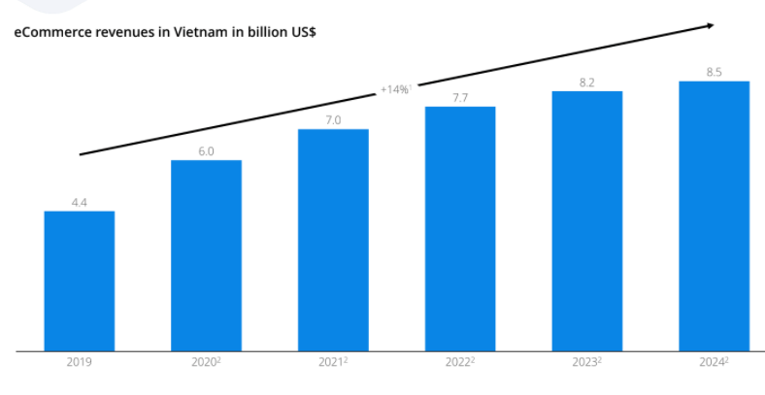
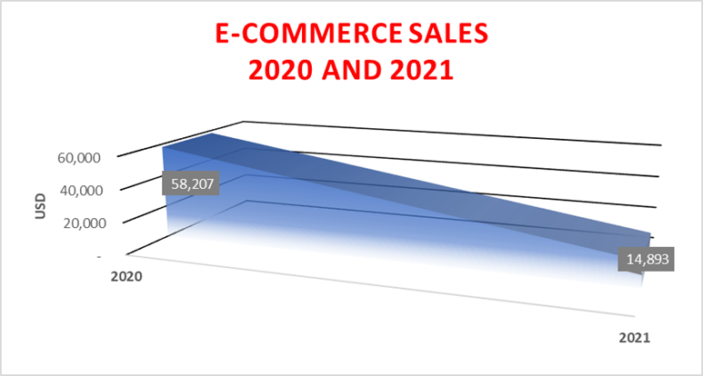
E-commerce Situation
The Vietnamese E-commerce market (*)
E-commerce sales in 2020 and 2021
^{(*)} https://marketreport.io/e-commerce-2020-vietnam#:~:text=The%20Vietnamese%20eCommerce%20market,-While%20many%20other&text=Specifically%2C%20the%20data%20showed%20in,it%20is%207%20billion%20USD

Slide 12
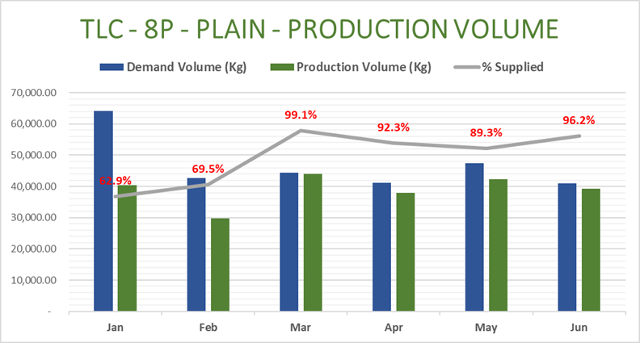
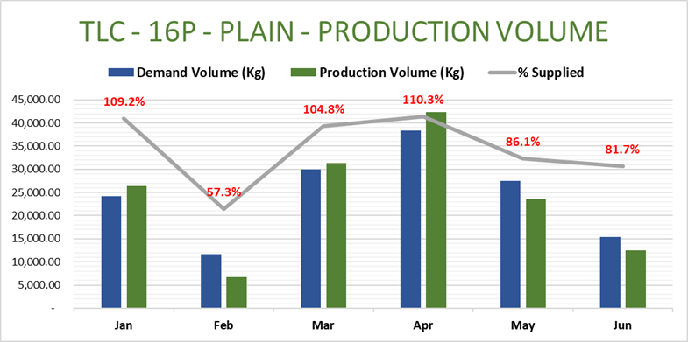
Product supply shortages
The production volume was lower than the demand
Production volume from Jan.21 to Jun.21

Slide 13
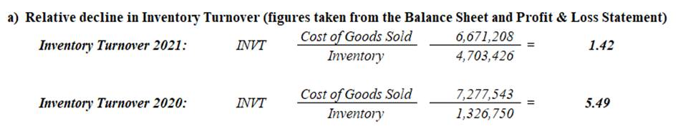
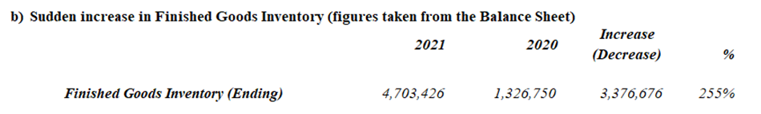
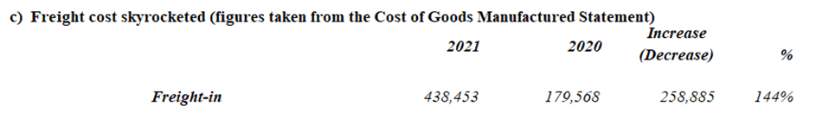
Inventory management failure

Slide 14
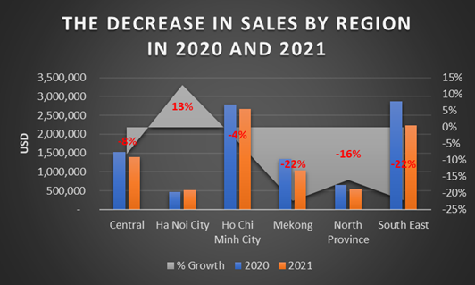
The decrease in sales by the regions that were negatively affected by the pandemic
The highest figures for decrease belong to South East and Mekong regions, which have been the most impacted ^{(*)} by Covid-19
https://www.gso.gov.vn/en/data-and-statistics/2021/10/report-on-the-covid-19-impacts-on-labour-and-employment-situation-in-the-third-quarter-of-2021/

Slide 15
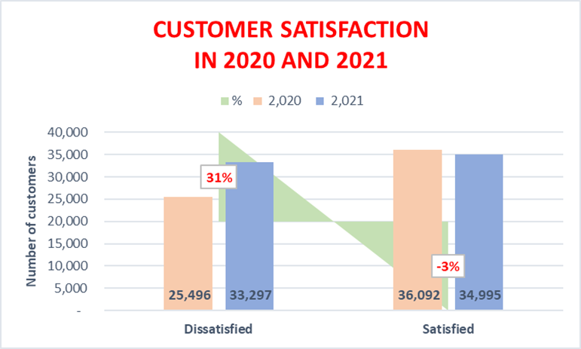
Customers satisfaction
The rate of customer satisfaction in the company plummeted between 2020 and 2021

Slide 16
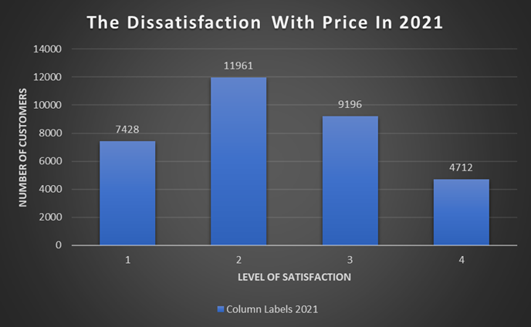
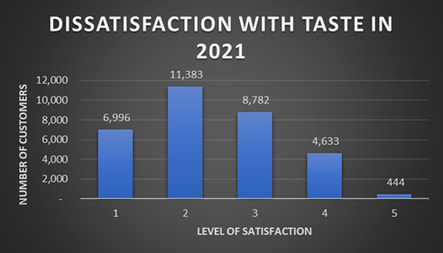
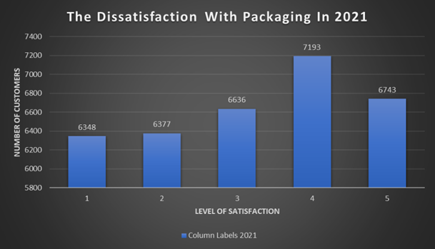
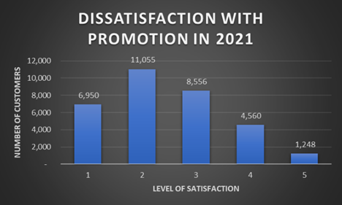
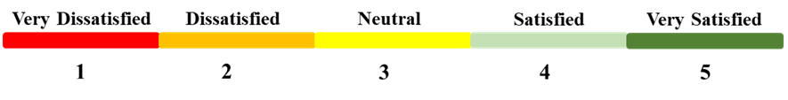
The reasons for the dissatisfaction of customers including

Slide 17
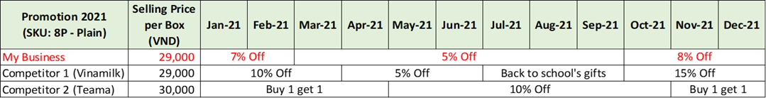
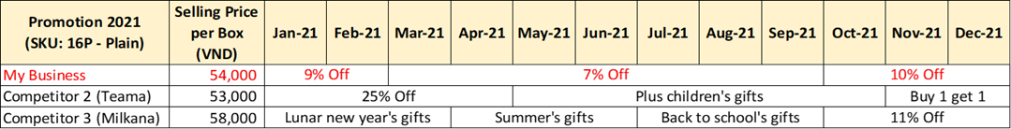
Activities of competitors
The promotions rates and types of competitors are attracted

Slide 18
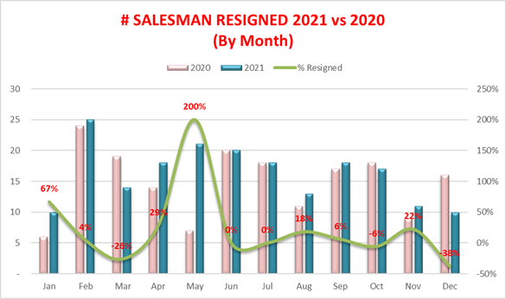
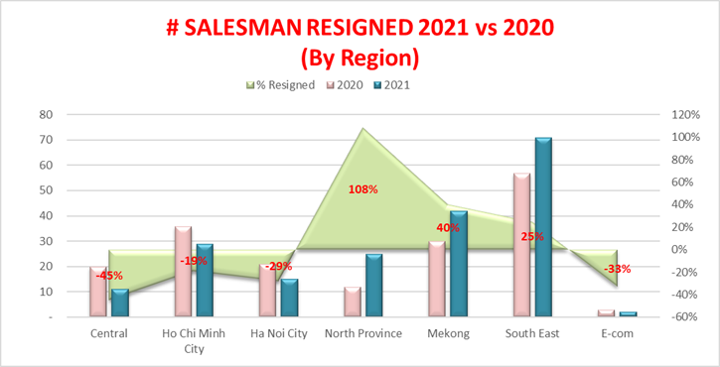
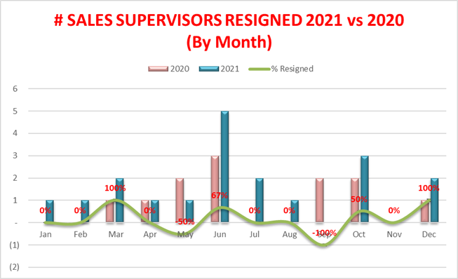
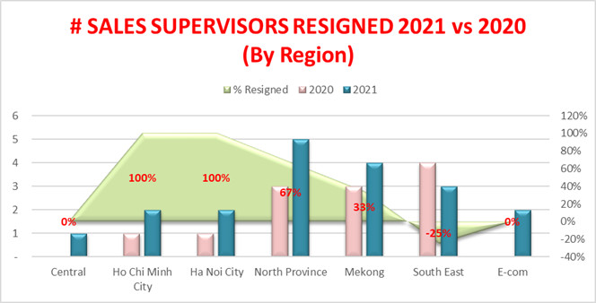
Sales employee turnover rate
Both turnover rates of salesman and sales supervisor increased

Slide 19
Lack of information system integration
Relying on Microsoft Excel can have disadvantages:
Difficult to access
Challenging to catch up with up-to-date information
https://www.gso.gov.vn/en/data-and-statistics/2021/10/report-on-the-covid-19-impacts-on-labour-and-employment-situation-in-the-third-quarter-of-2021/

Slide 20
4. Recommendation

Slide 21
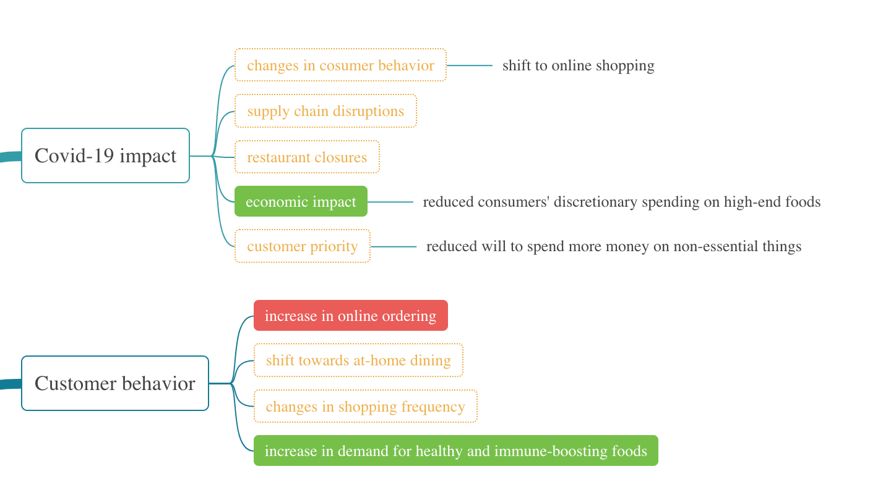
Issues about Covid-19(1)
The issues within the yellow dashed box are related to the epidemic, and the company
can't do much to prevent
them. The best solution is to
recover production and sales quickly in response to the
epidemic's effects.

Slide 22
Issues about Covid-19(2)
The issues highlighted within the
green box are related to the
pandemic, but the company can
take action to address them. For
example, the company could
introduce cheaper products to
encourage customers to buy during tough economic times. Additionally, the company could offer healthier
food options to meet increased
demand.

Slide 23
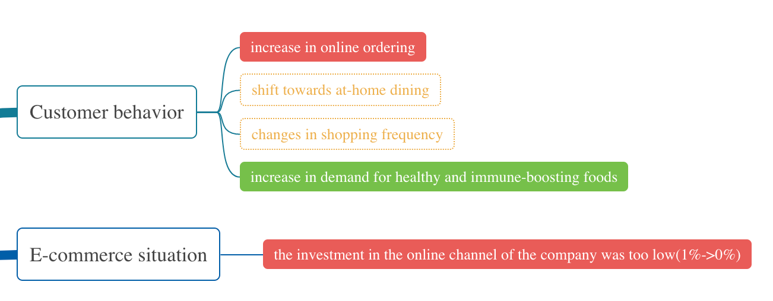
Issues about sales model & E-commerce
The issues highlighted within the red box are about a new sales model, where the company needs to create an online shopping team and
infrastructure to cater to the growing trend of online shopping.

Slide 24
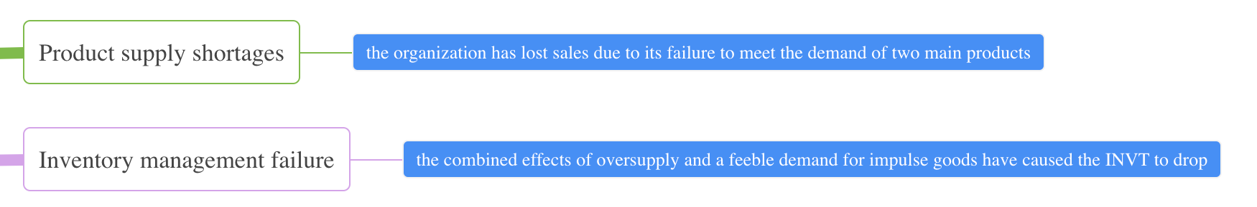
Issues about storage and inventory
The issues highlighted in the blue box are about managing storage and inventory. The company can use data analysis to predict when they'll need to restock, and
they can monitor data in real-time to optimize their warehouse and inventory
system.

Slide 25
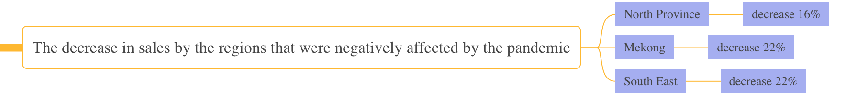
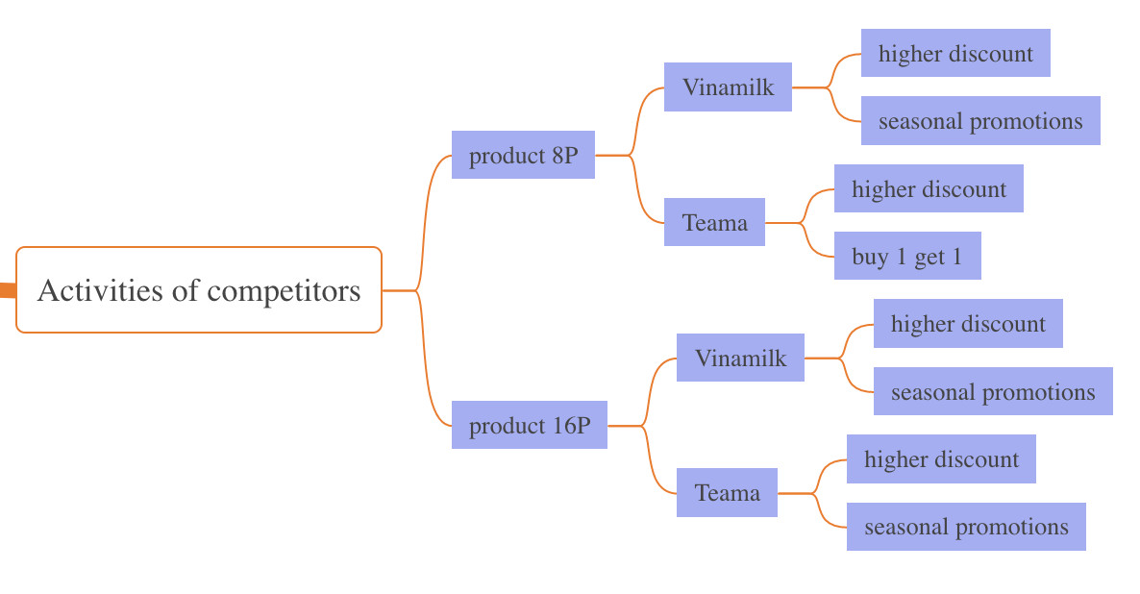
Issues about marketing
The issues within the purple box are related to marketing. The company needs to
adjust marketing strategies
for different regions, times,
and competitors to improve sales.

Slide 26
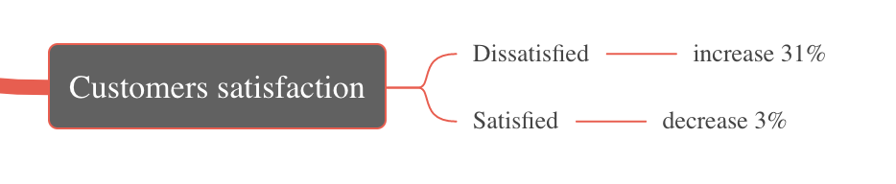
Issues about user satisfaction
The issues within the gray box are related to customer satisfaction. To address this, the company can lower prices or add low-priced, popular products. They also need to update their packaging regularly to make it attractive and user-friendly.

Slide 27
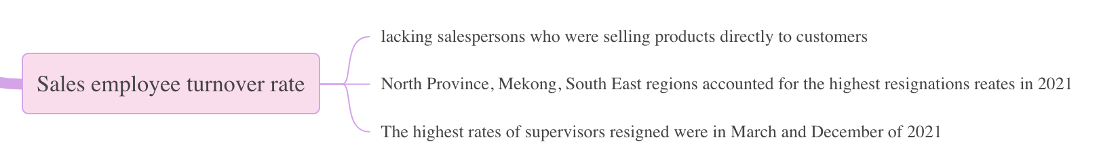
Issues about human resources
The contents within the pink box are related to human resources. The company
needs to investigate why employees are leaving and solve the problems to keep
them. They can also offer incentives to keep employees happy and conduct
surveys to predict turnover trends. It's also important to have a reserve of
personnel by recruiting new employees and promoting from within the company.

Slide 28
5. Conclusion

Slide 29
Several factors, including the pandemic, storage and inventory
management , marketing consumer happiness, and human resources, can be shown as influencing the cheese company's sales success based on the data analysis.
By adopting proactive steps, such as introducing more priced products,
improving the assortment of health-related items, establishing an online shopping team, obtaining customer feedback, and rewarding personnel, all the problems can be overcome. It is essential to be adaptable and flexible
to ensure the long-term existence of the company, especially in the face of unforeseen events like pandemics.

Slide 30
Thank you

